Slide 1

Past tenses
(Revision Work)
DCLE – Teacher Cristina Lorga

Slide 2
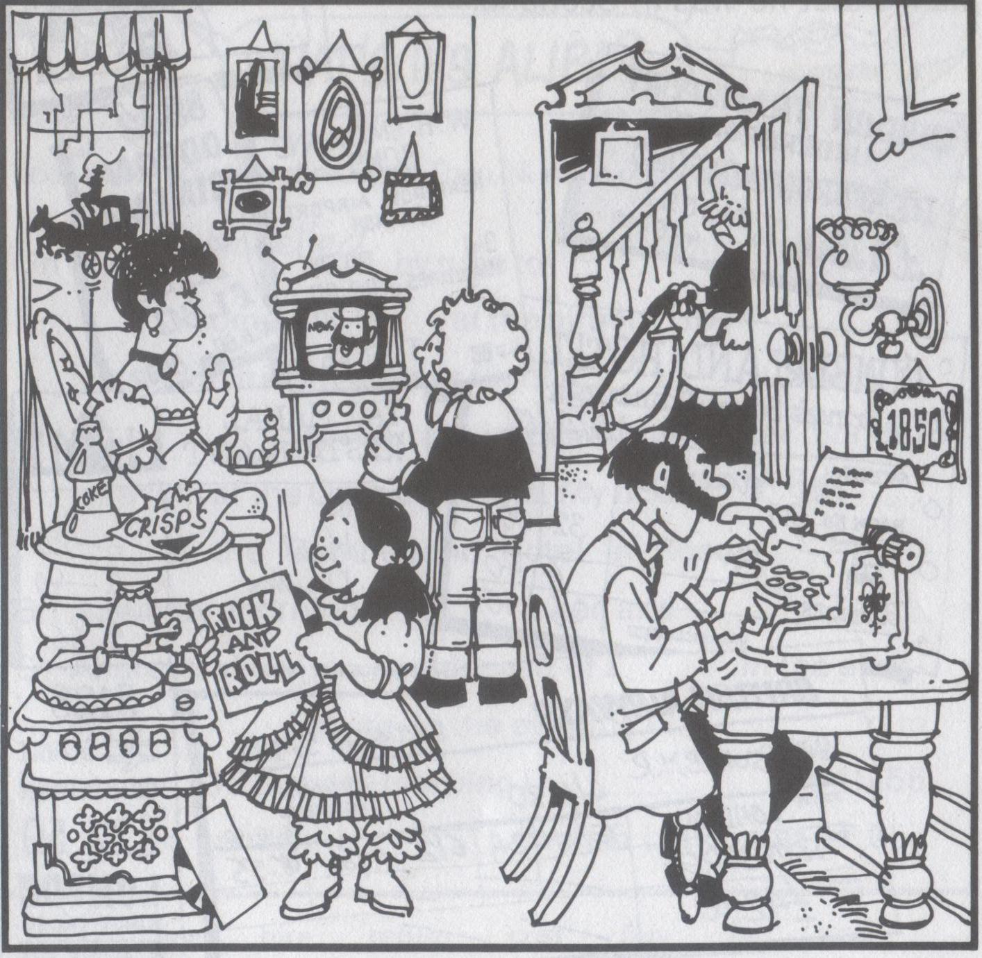
A. Look at this 19th century family scene and find the six mistakes. Start like this: “In 1850…”
… people didn’t watch TV.
… people didn’t use vacuum cleaners.
… people didn’t drink coke.
… people didn’t eat crisps.
… people didn’t listen to rock and roll.
… people didn’t type letters.

Slide 3
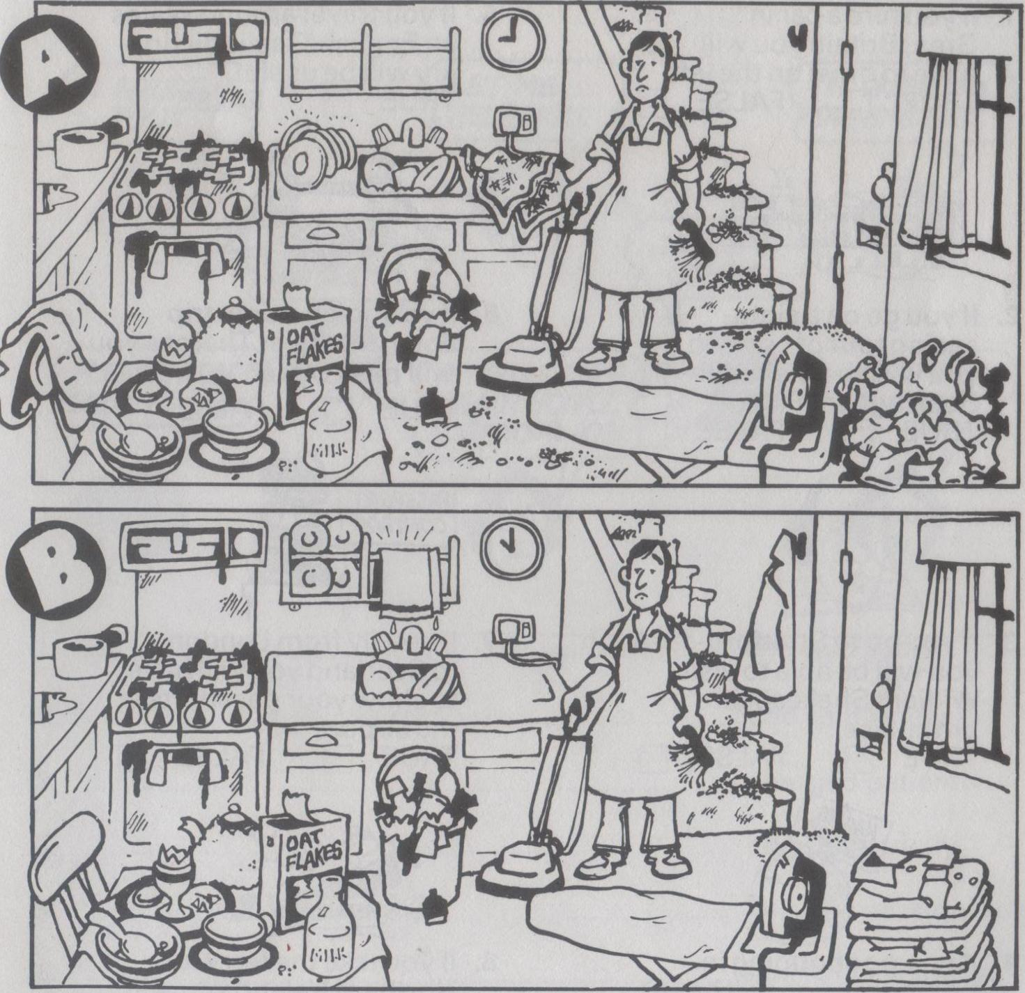
B. Frank does the housework every Saturday morning. Picture B shows him one hour later. What has he already done and what hasn’t he done yet?
He has vacuumed the floor.
He has hung up his jacket.
He has done the ironing.
He has put away the dishes.
He hasn’t cleaned the stove yet.
He hasn’t emptied the rubbish bin yet.
He hasn’t swept the stairs yet.
He hasn’t cleared the table yet.

Slide 4
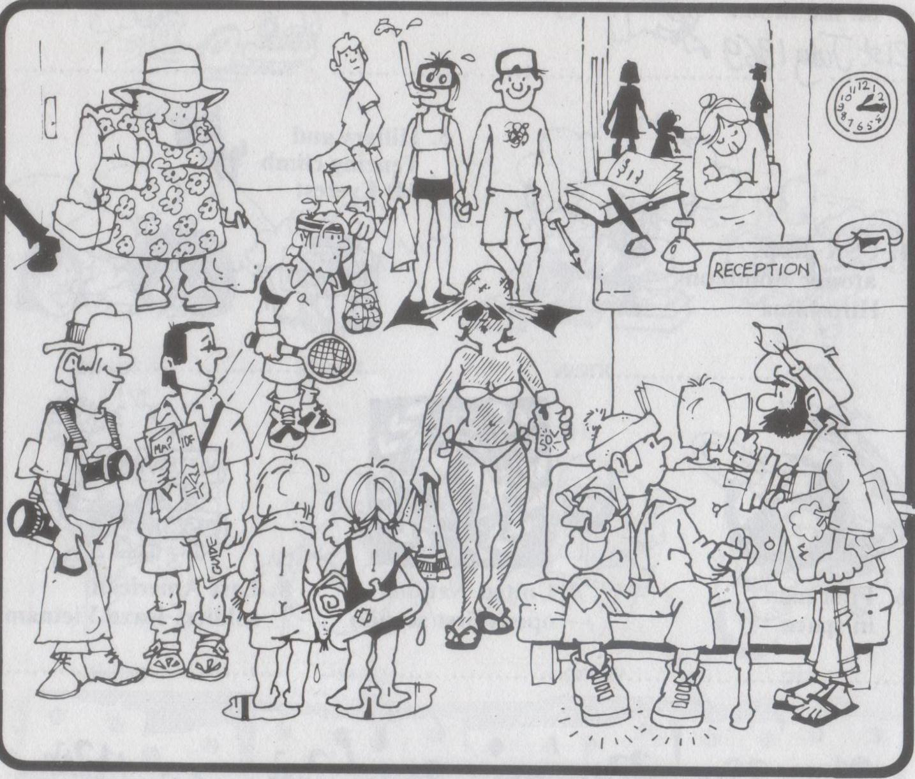
C. This is the reception of a holiday hotel. Say what some of these people have been doing this morning.
1
2
3
4
5
6
9
7
8
1 The lady has been shopping.
2 They have been diving.
8 He has been walking.
9 The bearded man has been painting.
6 The young lady has been getting sun-tanned.
7 The children have been swimming.
3 The receptionist has been sleeping.
4 The young man has been playing tennis.
5 They have been doing some sightseeing.

Slide 5
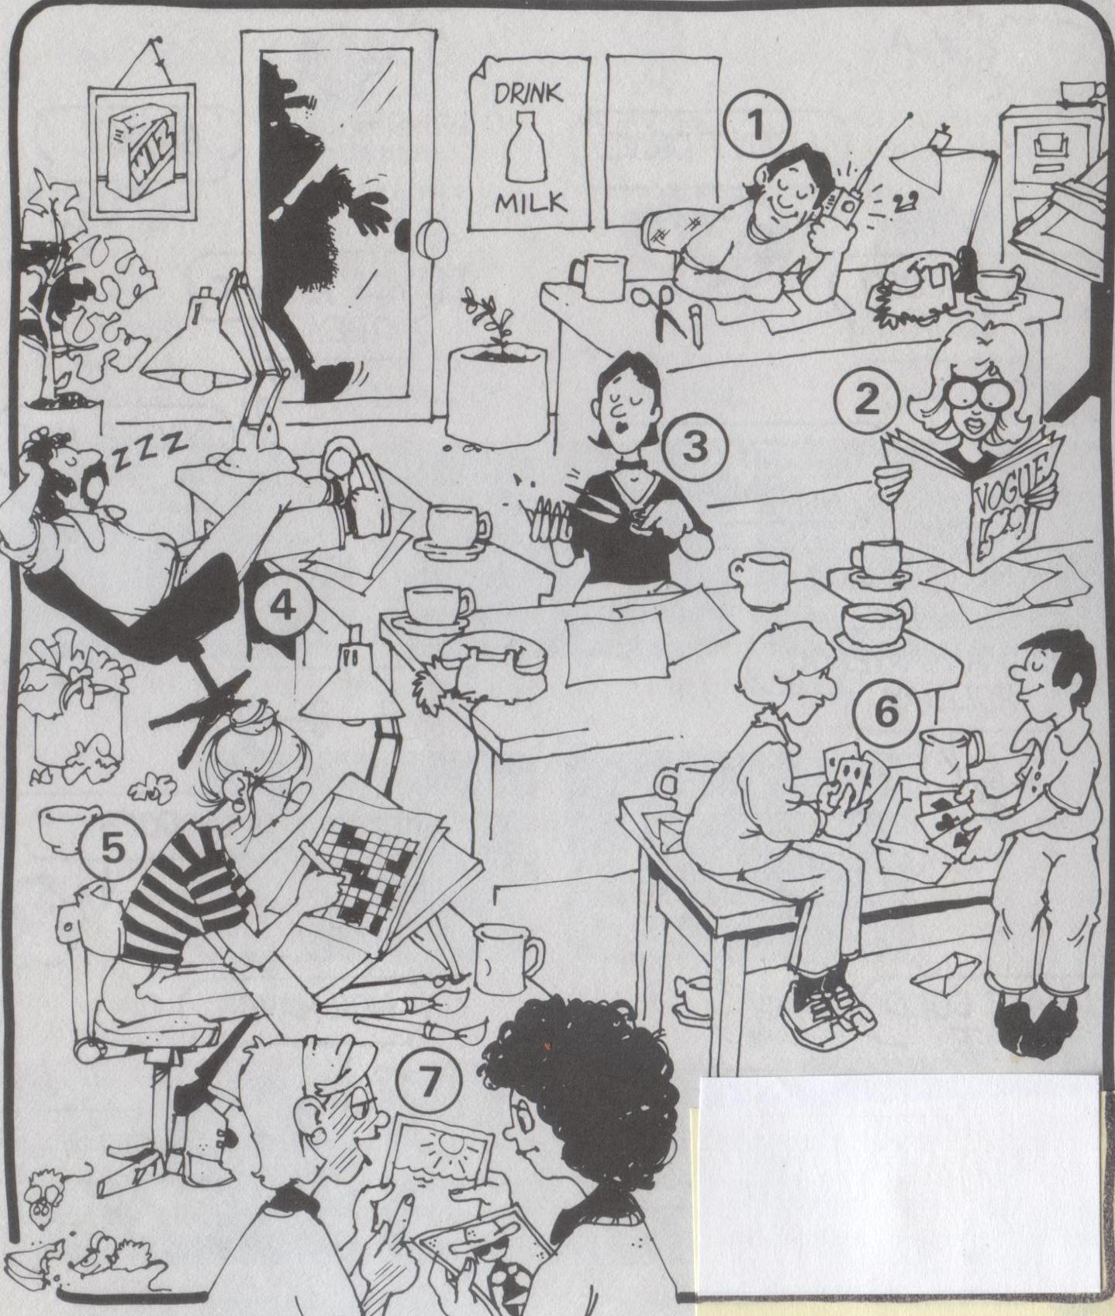

D. Everyone in the office thought their boss was out for the day when suddenly he opened the door…
You have two minutes to memorize what everyone is doing.

Slide 6
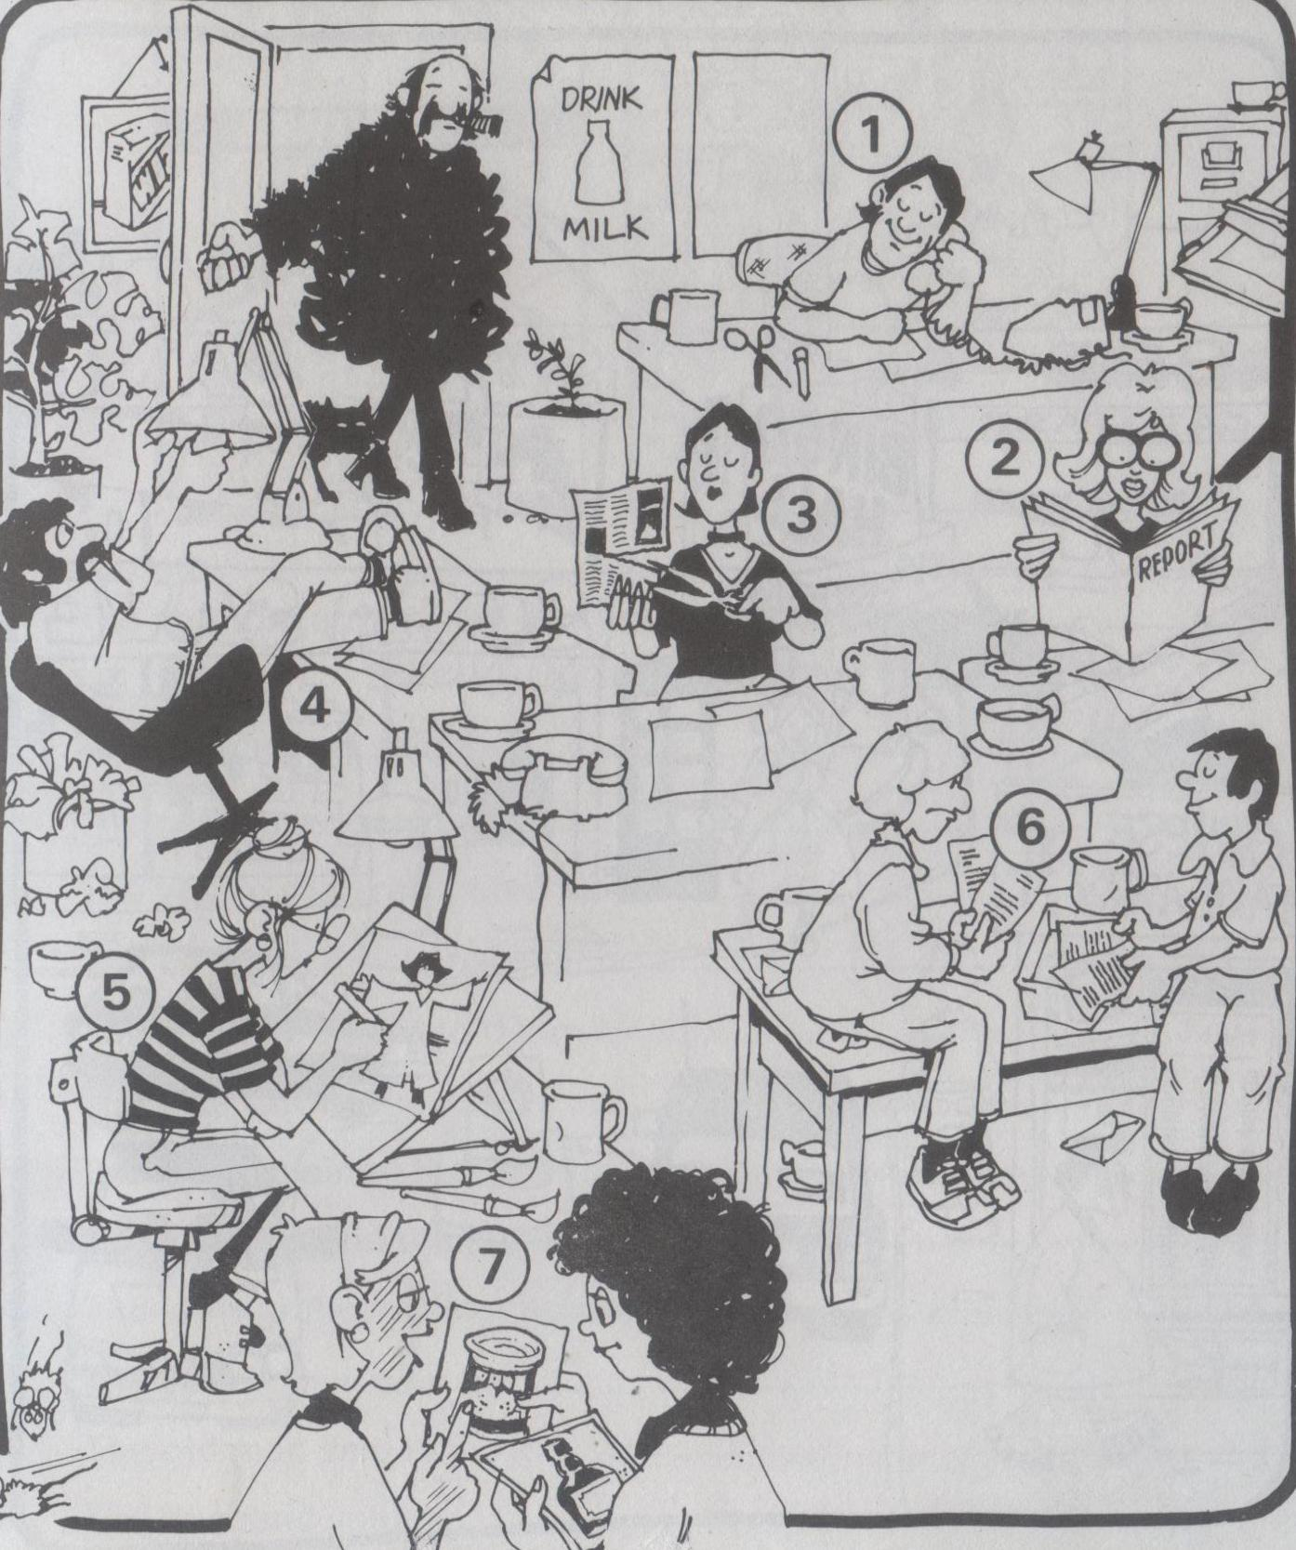
What were they all doing at the moment their boss opened the door?
5
She was doing a crossword puzzle.
2
She was reading Vogue magazine.
3
She was cutting her nails.
4
He was sleeping.
6
They were playing cards.
7
They were looking at some holiday photos.
1
He was listening to music.

Slide 7
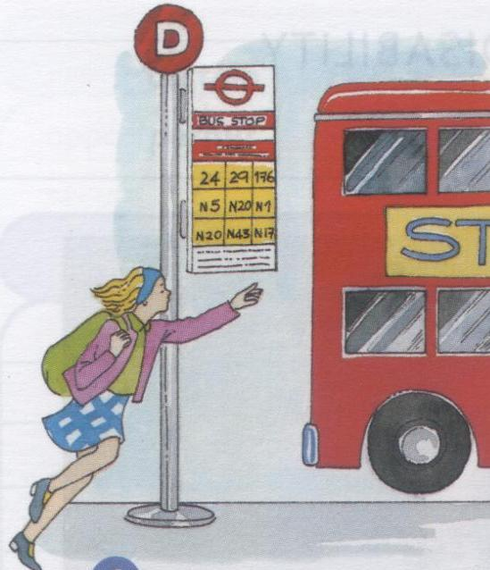
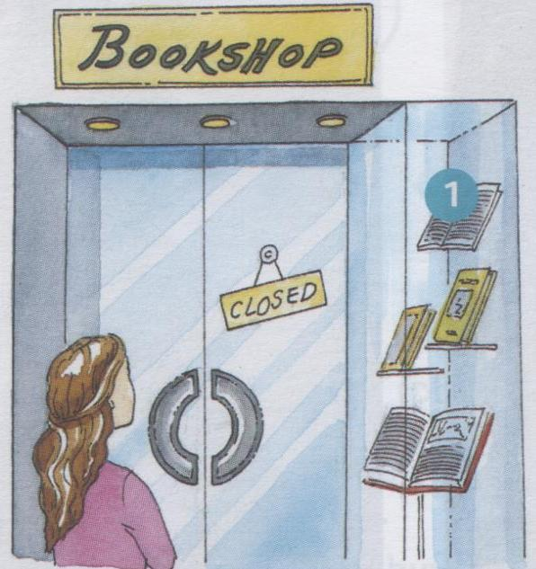
E. In each picture there is someone who is late for something. Say what had happened when they arrived.
When Mary arrived at the bus stop, the bus had left.
When Sophie arrived, the bookshop had closed.

Slide 8
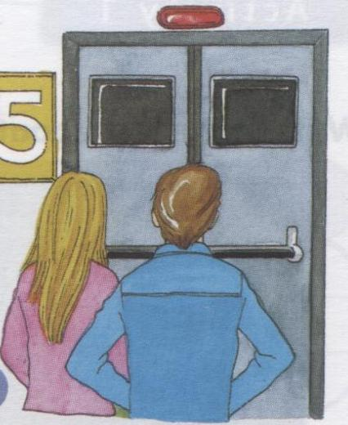
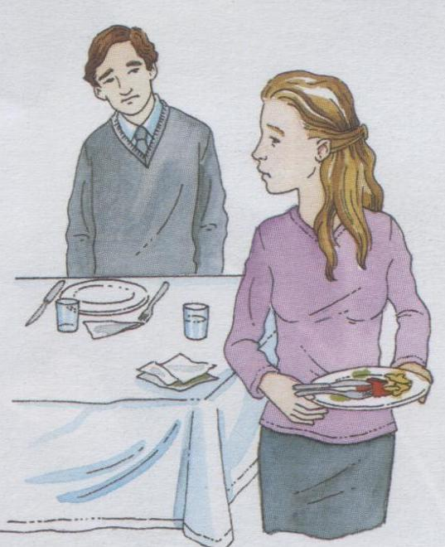
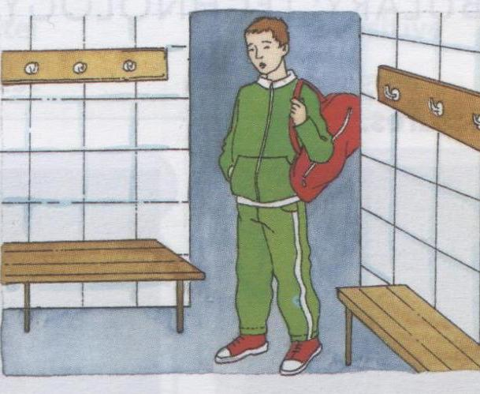
When Ann and William arrived at the cinema, the film had started.
When Paul arrived home, his wife had had dinner.
When Eliot arrived at the gym, the coach had left.

Slide 9
F. Can you guess what Mary, Sophie, Ann, William, Paul and Eliot had been doing before they arrived? What made them arrive late?
Mary had been __ing ...
Sophie had been __ing ...
Ann and William had been __ing ...
Paul had been __ing ...
Eliot had been __ing ...

Slide 10
SUMMARY
E.g. In 1850 people listened to classical music.
Past Simple (Simple Past)
- Regular Verbs : verb + ed
- Irregular Verbs : second column of the list
E.g. Paul has done the ironing.
Present Perfect
has / have + verb in the Past Participle *
*
Regular Verbs : verb + ed
Irregular Verbs : third column of the list

Slide 11
E.g. He has been walking.
Present Perfect Continuous
has / have been + verb in the -ing form.
E.g. She was cutting her nails.
Past Continuous
was / were + verb in the -ing form.
E.g. When Mary arrived, the bus had left.
Past Perfect
had + verb in the Past Participle *
E.g. Mary had been talking to a friend.
Past Perfect Continuous
had been+ verb in the -ing form

