Slide 1
RELATIVE CLAUSES

Slide 2

RELATIVE CLAUSES
Relative clauses are clauses starting with the relative pronouns who*, that, which, whose, where, when. They are most often used to define or identify the noun that precedes them.

Slide 3
RELATIVE CLAUSES
* There is a relative pronoun whom, which can be used as the object of the relative clause. For example:
  My science teacher is a person whom I like very much.
To many people the word whom now sounds old-fashioned, and it is rarely used in spoken English.

Slide 4
RELATIVE CLAUSES
Examples
Do you know the girl who started in grade 7 last week?
Can I have the pencil that I gave you this morning?
A notebook is a computer which can be carried around.
I won't eat in a restaurant whose cooks smoke.
I want to live in a place where there is lots to do.
Yesterday was a day when everything went wrong!

Slide 5
RELATIVE CLAUSES
Relative pronouns are associated as follows with their preceding noun:
Preceding noun | Relative pronoun | examples
A person | Who(m), that, whose | Do you know the girl who lives in the corner? He was a man that made jewels He is the man whose car was stolen
A thing | Which, that, whose | Do you have a computer which can store much information? The store that sells fish is closed This is the book whose author was German.

Slide 6
RELATIVE CLAUSES
Note 1
The relative pronoun whose is used in place of the possessive pronoun. It must be followed by a noun.
Example:
  There's a boy in grade 8 whose father is a professional tennis player.
  (There's a boy in grade 8. His father is a professional tennis player.)

Slide 7
RELATIVE CLAUSES
Note 2
The relative pronouns where and when are used with place and time nouns.
Examples:
  FIS is a school where children from more than 50 countries are educated.
  2001 was the year when terrorists attacked the Twin Towers in New York.

Slide 8
RELATIVE CLAUSES
Some relative clauses are not used to define or identify the preceding noun (Defining Relative Clauses) but to give extra information about it.
Non-Defining Relative Clauses

Slide 9
NON-DEFINING
RELATIVE CLAUSES
My ESL teacher, who came to Germany in 1986, likes to ride his mountain bike.
The heavy rain, which was unusual for the time of year, destroyed most of the plants in my garden.
The boy, whose parents both work as teachers at the school, started a fire in the classroom.
In the summer I'm going to visit Italy, where my brother lives.

Slide 10
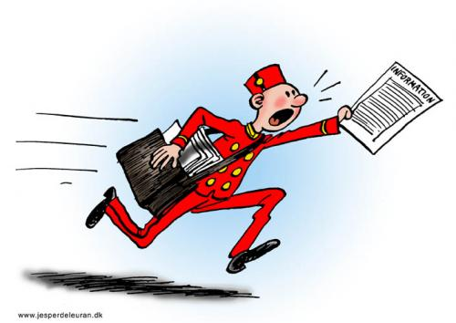
NON-DEFINING
RELATIVE CLAUSES
Note 1
Relative clauses which give extra information, as in the previous sentences, must be separated off by commas.

Slide 11
NON-DEFINING
RELATIVE CLAUSES
Note 2
The relative pronoun that cannot be used to introduce an extra-information (non-defining) clause about a person.
  Wrong: Neil Armstrong, that was born in 1930, was the first man to stand on the moon.
  Correct: Neil Armstrong, who was born in 1930, was the first man to stand on the moon.

Slide 12
RELATIVE CLAUSES – omission of the relative pronoun
There are two common occasions, particularly in spoken English, when the relative pronoun is omitted:
1- when the pronoun is the object of the relative clause. In the following sentences the pronoun that can be left out is enclosed in (brackets).
EXAMPLES

Slide 13
RELATIVE CLAUSES – omission of the relative pronoun
Do you know the girl (who/m) he is talking to?
Where's the pencil (which) I gave you yesterday?
I haven't read any of the books (that) I got for Christmas.
I didn't like that girl (that) you brought to the party.
Did you find the money (which) you lost?

Slide 14
RELATIVE CLAUSES – omission of the relative pronoun
Note: you cannot omit the relative pronoun
a) if it starts a non-defining relative clause, or,
b) if it is the subject of a defining relative clause.
For example, who is necessary in the following sentence:
  What's the name of the girl who won the tennis tournament?

Slide 15
RELATIVE CLAUSES – omission of the relative pronoun
2- When the relative clause contains the auxiliary verb to be followed by a gerund or past participle. In such cases both relative pronoun and auxiliary can be left out.
EXAMPLES

Slide 16
RELATIVE CLAUSES – omission of the relative pronoun
Who's that man (who is) standing by the gate?
The family (that is) living in the next house comes from Slovenia.
She was wearing a dress (which was) covered in blue flowers.
Most of the parents (who were) invited to the conference did not come.
Anyone (that is) caught writing on the walls will be expelled from school.

Slide 17
Ready to do the exercises?
Let’s do it!

